Slide 1



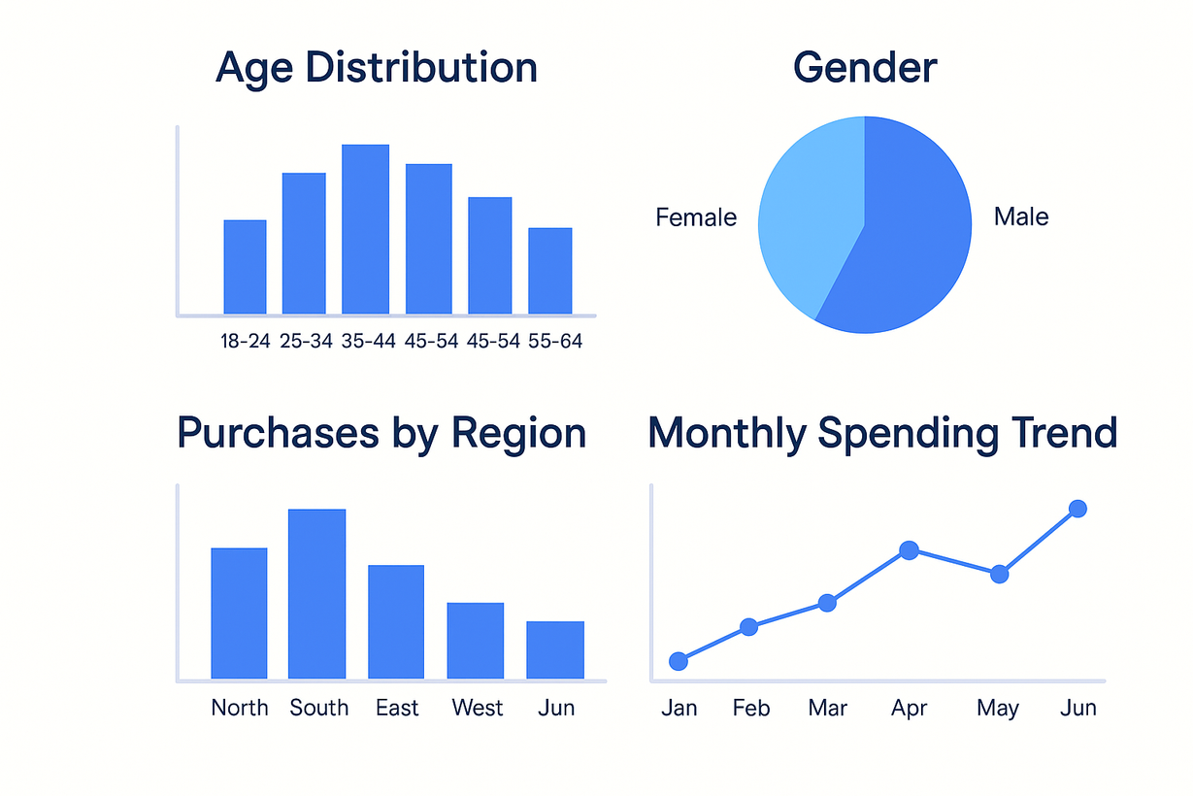
CUSTOMER DEMOGRAPHICS AND PURCHASE BEHAVIOR ANALYSIS
By A.BHARATHI
BATCH NO :BMAI-S-WD-T-B15

Slide 2
AGENDA
CUSTOM DEMOGRAPHICS
PURCHASE BEHAVIOR
MONTHLY TRENDS
ADVANCED INSIGHTS
KEY TAKEAWAYS & RECOMMENDATIONS

Slide 3

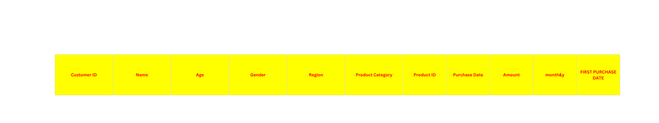
TASK 1: STYLING TABULATION
BOLD HEADERS, APPLY ALTERNATING ROW COLORS, AND FORMAT THE AMOUNT COLUMN AS CURRENCY
TO IMPROVE READABILITY

Slide 4
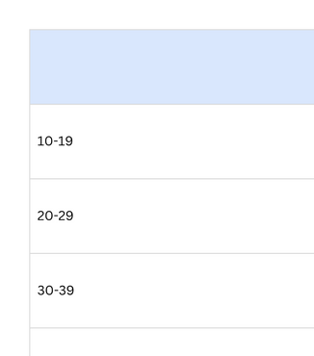
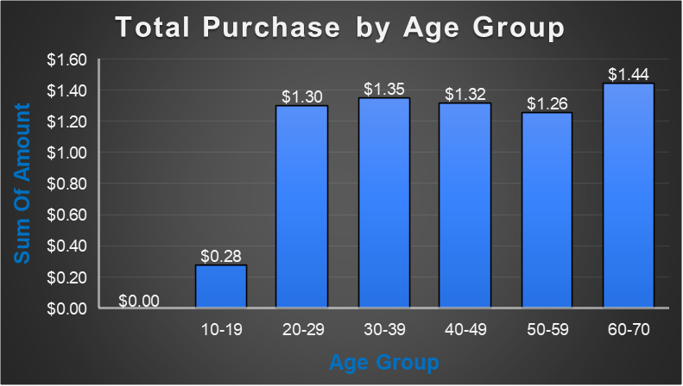

TASK 2: AGE DISTRIBUTION HISTOGRAM
INSIGHTS ;
CUSTOMERS AGED 60–70 ARE THE MOST PROMINENT SPENDERS, FOLLOWED CLOSELY BY THE 30–49 AGE GROUPS, WHILE THE 10–19 GROUP CONTRIBUTES THE LEAST.

Slide 5
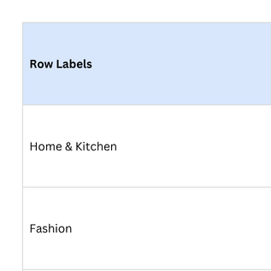
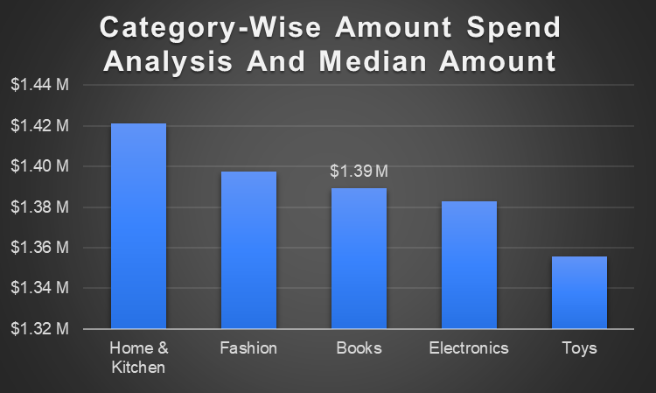
TASK 3: BOX PLOT FOR PURCHASE AMOUNTS
INSIGHTS;
HOME & KITCHEN LEADS IN SPENDING, TOYS IS A LOW-PERFORMING OUTLIER, AND BOOKS REPRESENT THE MEDIAN SPENDING LEVEL ACROSS CATEGORIES.

Slide 6
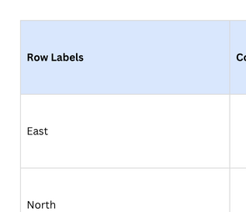
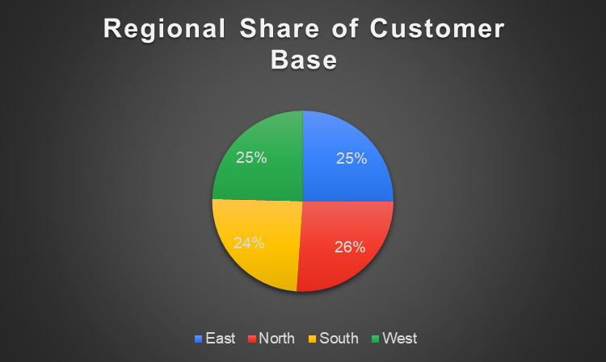
TASK 4: PIE CHART FOR CUSTOMER DISTRIBUTION
INSIGHTS;
NORTH LEADS WITH 26% OF THE CUSTOMER BASE, MAKING IT THE MOST DOMINANT REGION, WHILE SOUTH LAGS SLIGHTLY AT 24%.

Slide 7
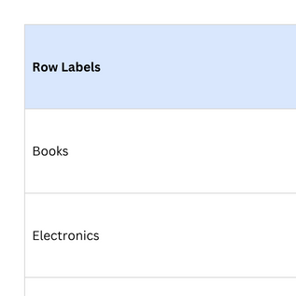
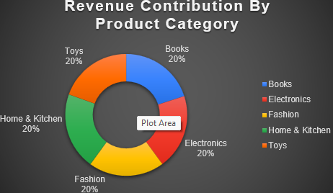
TASK 5: DONUT CHART FOR PRODUCT REVENUE CONTRIBUTION
INSIGHTS;
HOME & KITCHEN GENERATES THE HIGHEST REVENUE, WHILE TOYS CONTRIBUTE THE LEAST, THOUGH OVERALL CATEGORY PERFORMANCE IS RELATIVELY BALANCED.

Slide 8
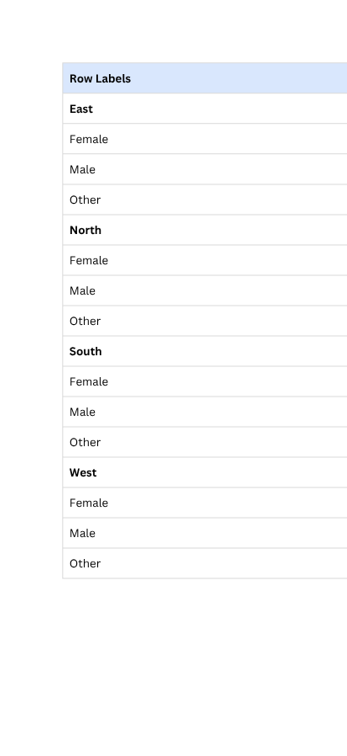
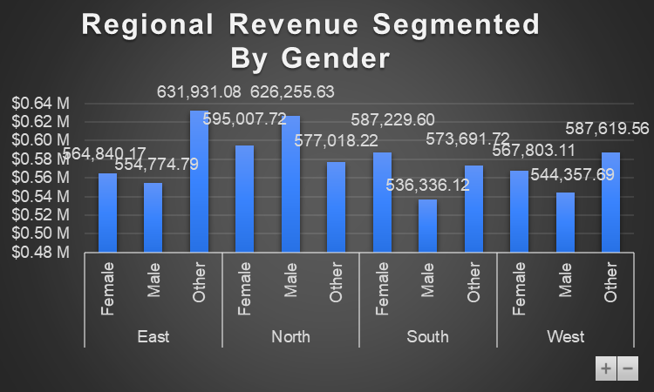
TASK 6: STACKED BAR PLOT FOR REGIONAL REVENUE BY GENDER
INSIGHTS:
NORTH LEADS IN REGIONAL REVENUE, WITH STRONG CONTRIBUTIONS ACROSS ALL GENDERS, ESPECIALLY THE 'OTHER' CATEGORY, WHILE WEST LAGS SLIGHTLY IN TOTAL REVENUE.

Slide 9
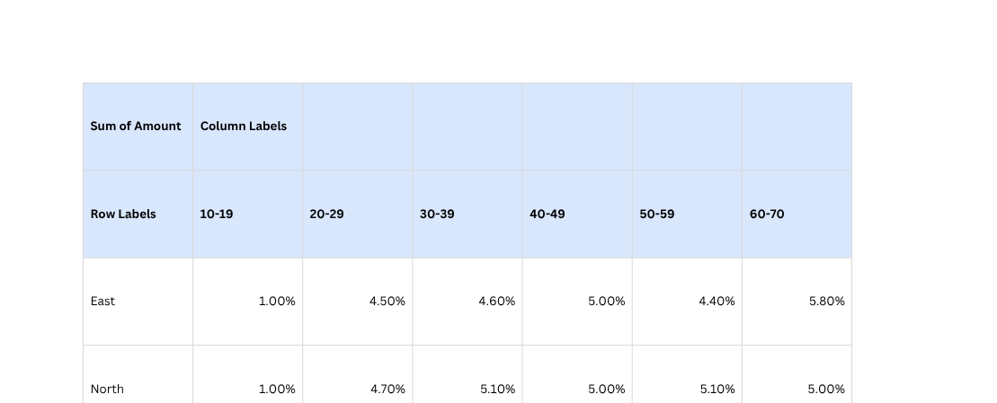
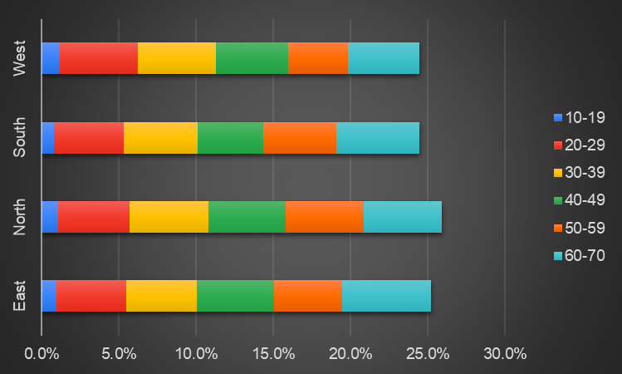
TASK 7: RELATIVE STACKED BAR PLOT FOR AGE GROUPS
INSIGHTS;
THE 30–70 AGE GROUP DOMINATES PURCHASES ACROSS ALL REGIONS, WITH THE 60–70 SEGMENT LEADING, ESPECIALLY IN THE WEST, WHILE THE 10–19 GROUP CONTRIBUTES THE LEAST OVERALL.

Slide 10
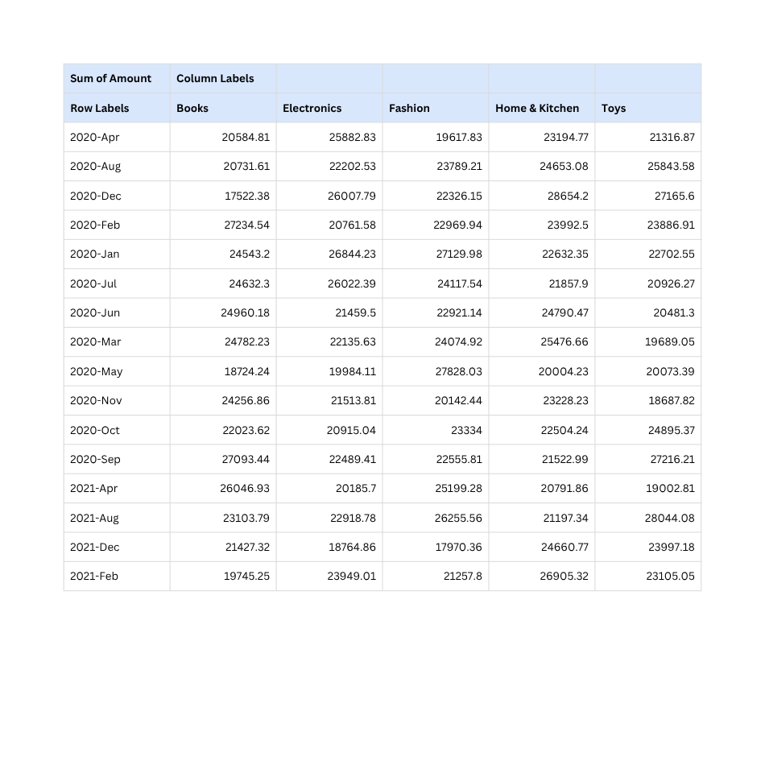
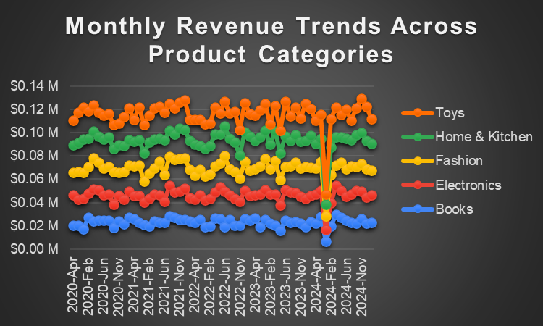
TASK 8: STACKED AREA PLOT FOR MONTHLY REVENUE
INSIGHTS;
TOYS AND HOME & KITCHEN CONSISTENTLY LEAD MONTHLY REVENUES, WHILE FASHION AND ELECTRONICS SHOW VOLATILITY, AND BOOKS REMAIN THE LOWEST CONTRIBUTOR—WITH A SHARP DECLINE ACROSS ALL CATEGORIES IN DEC 2024 SIGNALING A POTENTIAL ANOMALY OR DISRUPTION.

Slide 11
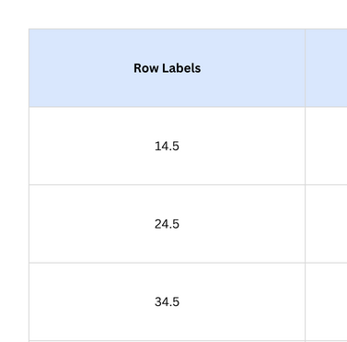
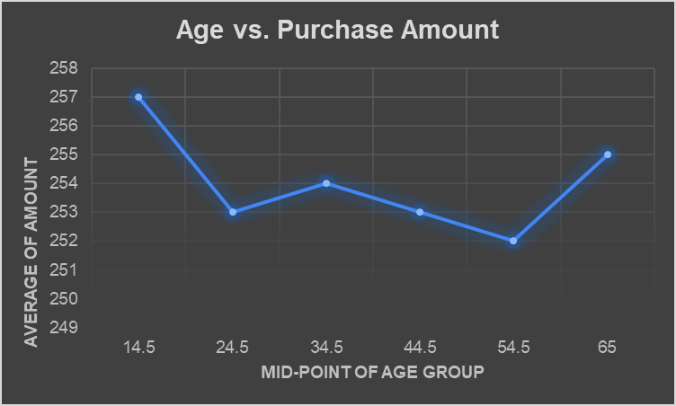
TASK 9: SCATTER PLOT FOR AGE VS. PURCHASE AMOUNT
INSIGHTS;
PURCHASE AMOUNTS ARE HIGHEST AT AGE 14.5, DIP DURING MIDDLE AGE, AND RISE AGAIN SLIGHTLY BY AGE 65, INDICATING A U-SHAPED SPENDING TREND ACROSS AGE GROUPS.

Slide 12
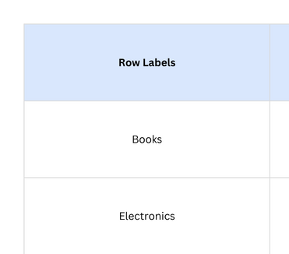
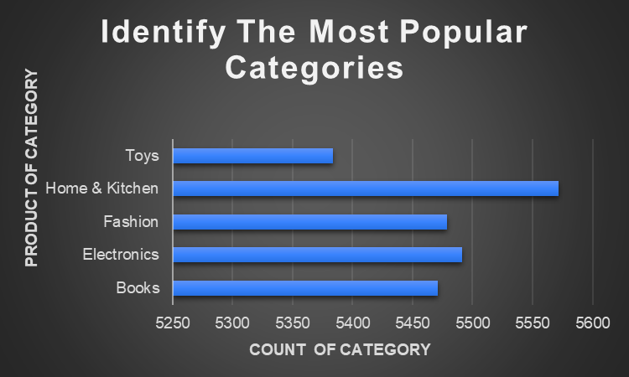
TASK 10: BAR PLOT FOR TOTAL PURCHASES
INSIGHTS;
"HOME & KITCHEN" TOPS THE CHART WITH THE HIGHEST NUMBER OF PURCHASES, WHILE "TOYS", DESPITE BEING HIGH IN REVENUE, RANKS LOWEST IN PURCHASE FREQUENCY — INDICATING FEWER BUT HIGHER-VALUE SALES.

Slide 13
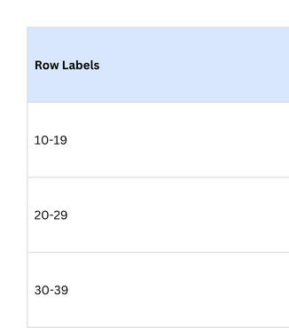
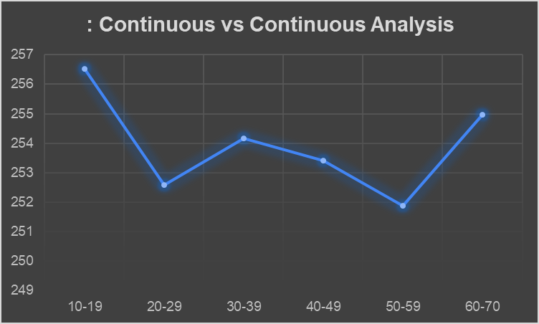
TASK 11: CONTINUOUS VS CONTINUOUS ANALYSIS
INSIGHTS;
PURCHASE AMOUNTS STEADILY INCREASE WITH CUSTOMER AGE UNTIL MIDDLE ADULTHOOD, WHERE SPENDING PEAKS

Slide 14
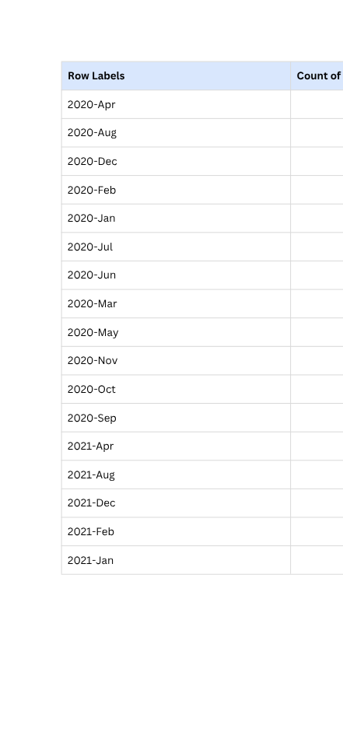
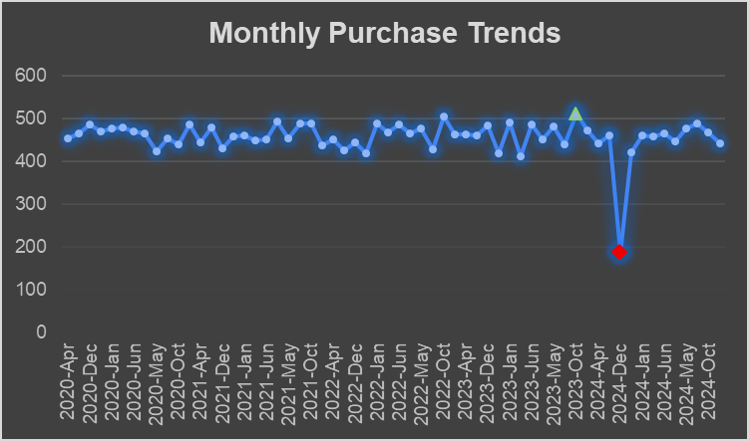
TASK 12: LINE PLOT FOR MONTHLY PURCHASE TRENDS
INSIGHTS;
PURCHASES SHOWED CONSISTENT STABILITY OVER TIME, PEAKING IN OCTOBER 2023 DUE TO SEASONAL DEMAND, WHILE A SHARP DROP IN DECEMBER 2024 SUGGESTS A POTENTIAL DISRUPTION OR OFF-SEASON EFFECT.

Slide 15
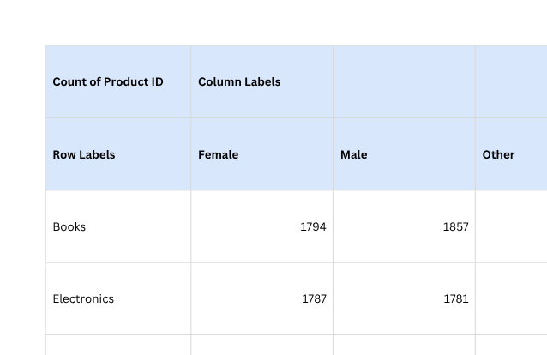
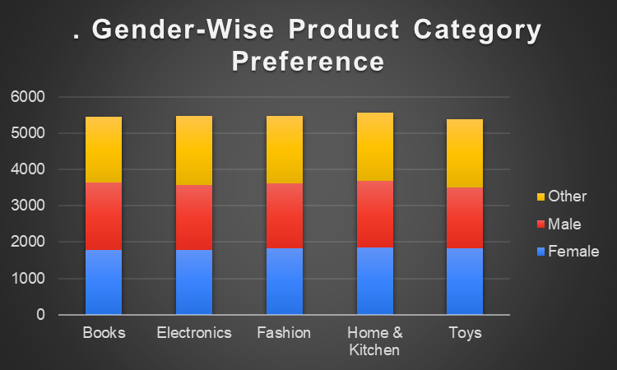
TASK 13: GENDER-WISE PRODUCT CATEGORY PREFERENCE
INSIGHTS;
"OTHER" GENDER CATEGORY SHOWS A DISTINCT PREFERENCE FOR ELECTRONICS AND TOYS COMPARED TO FEMALE AND MALE CONSUMERS

Slide 16
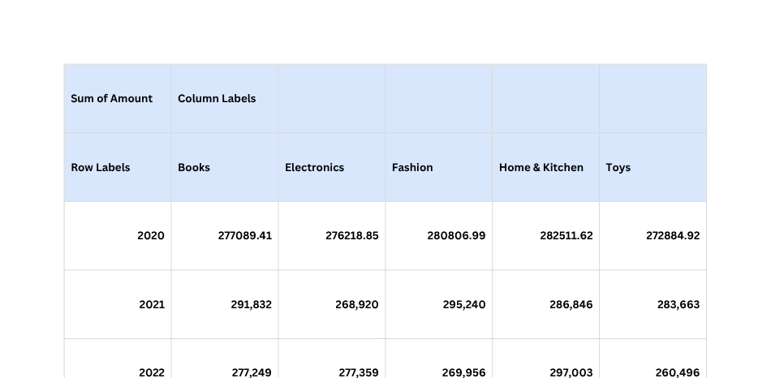
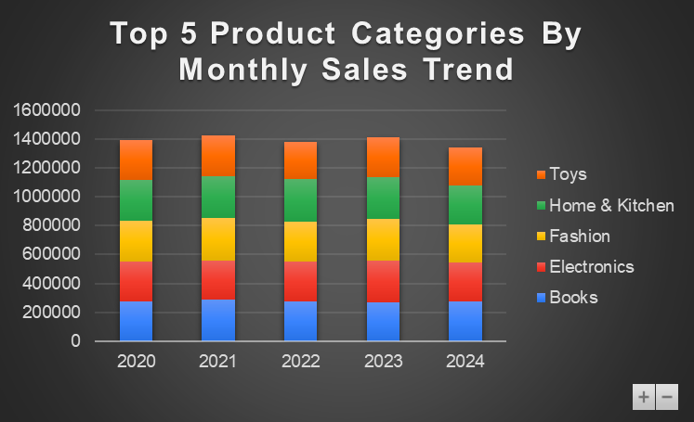
TASK 14: TOP 5 PRODUCT CATEGORIES BY MONTHLY SALES TREND
INSIGHTS;
OVER THE YEARS, FASHION CONSISTENTLY LEADS IN MONTHLY SALES, FOLLOWED BY ELECTRONICS, HOME & KITCHEN, BOOKS, AND TOYS, WITH PEAK SALES SEEN DURING MID-YEAR AND FESTIVE MONTHS, REVEALING STRONG SEASONAL SHOPPING TRENDS.

Slide 17
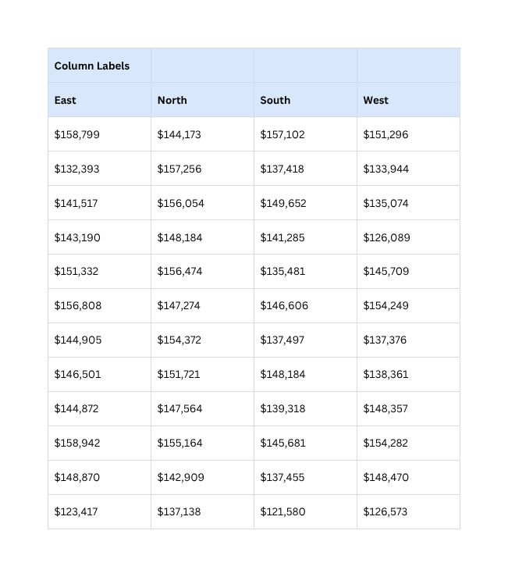
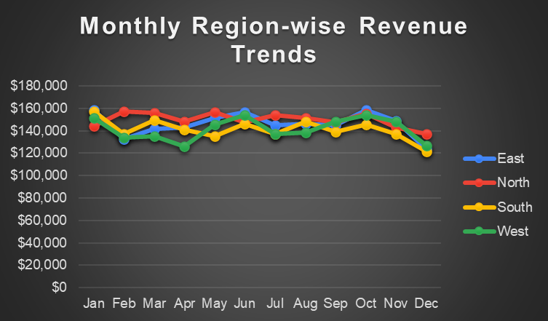
TASK 15: MONTHLY REGION-WISE REVENUE TRENDS
INSIGHTS;
THE EAST REGION CONSISTENTLY LEADS IN MONTHLY REVENUE, ESPECIALLY IN Q1 AND Q4, WHILE SOUTH AND WEST SHOW STABLE BUT FLUCTUATING PERFORMANCE, AND NORTH MAINTAINS MODERATE SALES WITH OCCASIONAL PEAKS—HIGHLIGHTING EAST AS THE MOST DOMINANT MARKET THROUGHOUT THE YEAR.

Slide 18
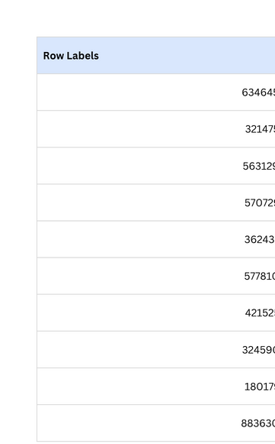
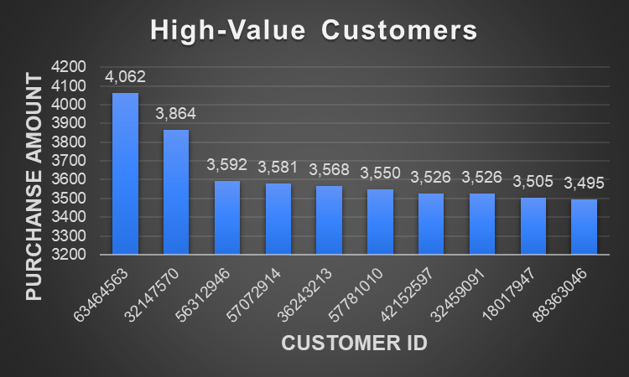
TASK 16: HIGH-VALUE CUSTOMERS
INSIGHTS;
CUSTOMER 63464563 STANDS OUT AS THE HIGHEST-VALUE SPENDER, WHILE OTHERS CLUSTER CLOSELY IN SPEND RANGE

Slide 19
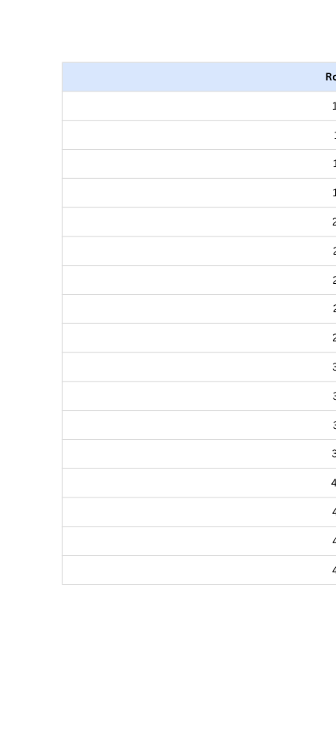
TASK 17: PRODUCT BUYING REAPET CUSTOMERS PERCENTAGE ANALYSIS
INSIGHTS;
AMONG 4,532 CUSTOMERS, 477 (11%) ARE REPEAT BUYERS, EACH PURCHASING 10 PRODUCTS

Slide 20
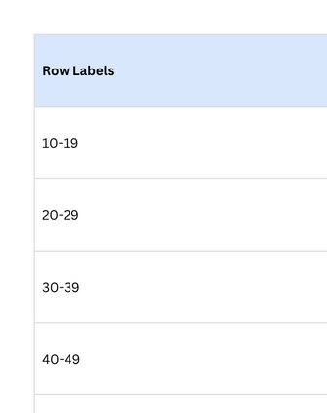
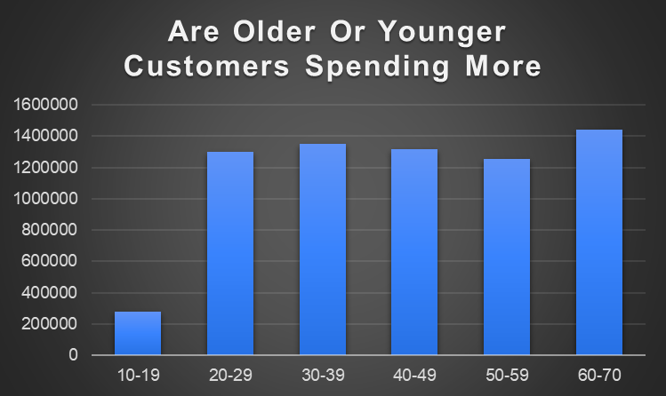
TASK 18: ARE OLDER OR YOUNGER CUSTOMERS SPENDING MORE
INSIGHTS;
OLDER CUSTOMERS, ESPECIALLY THOSE AGED 60–70, SPEND THE MOST, WHILE YOUNGER CUSTOMERS AGED 10–19 SPEND THE LEAST.

Slide 21
METHODOLOGY
🧩 STEP-BY-STEP METHODOLOGY
1.DATA PREPARATION:
ORGANIZE THE RAW DATASET WITH COLUMNS LIKE CUSTOMER ID, AGE, GENDER, REGION, PRODUCT CATEGORY, PURCHASE DATE, AND PURCHASE AMOUNT.
ENSURE DATA IS CLEAN: REMOVE DUPLICATES, FILL MISSING VALUES, AND FORMAT DATES PROPERLY.
2.CREATE A PIVOT TABLE:
SELECT THE DATASET AND INSERT A PIVOT TABLE (INSERT > PIVOTTABLE).
PLACE THE PIVOT ON A NEW WORKSHEET FOR CLARITY.
3.DEMOGRAPHIC SEGMENTATION:
ROWS: USE FIELDS LIKE GENDER, AGE GROUP, OR REGION.
VALUES: SUM OF AMOUNT OR COUNT OF TRANSACTIONS.
THIS HELPS VISUALIZE PURCHASE BEHAVIOR ACROSS DEMOGRAPHICS.

Slide 22
4.BEHAVIORAL INSIGHTS:
USE CUSTOMER ID IN ROWS, WITH COUNT OF PRODUCT PURCHASES IN VALUES TO IDENTIFY FREQUENT BUYERS.
GROUP PURCHASE DATES BY MONTH/QUARTER/YEAR TO OBSERVE SEASONAL TRENDS.INCLUDE PRODUCT CATEGORY TO STUDY CATEGORY-WISE PREFERENCES.
5.REPEAT CUSTOMER IDENTIFICATION:
USE PIVOT WITH CUSTOMER ID AND COUNT OF DISTINCT PRODUCT NAMES TO DETECT REPEAT PURCHASES.
FILTER TO DISPLAY CUSTOMERS PURCHASING MORE THAN ONCE OR HIGH-VALUE ITEMS.
6.VISUAL REPRESENTATION:
GENERATE CHARTS LIKE:
BAR CHART FOR PURCHASE FREQUENCY BY REGION/GENDER.
LINE CHART FOR SALES TREND OVER MONTHS.
PIE CHART FOR CATEGORY CONTRIBUTION.

Slide 23
THANK YOU

